Slide 1


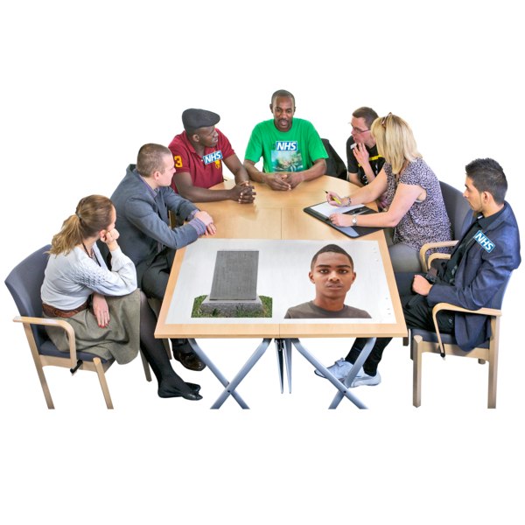
NHS Frimley
LeDeR Report
Learning from the lives and deaths of people with learning disabilities and autism.
April 2023 – March 2024

Slide 2
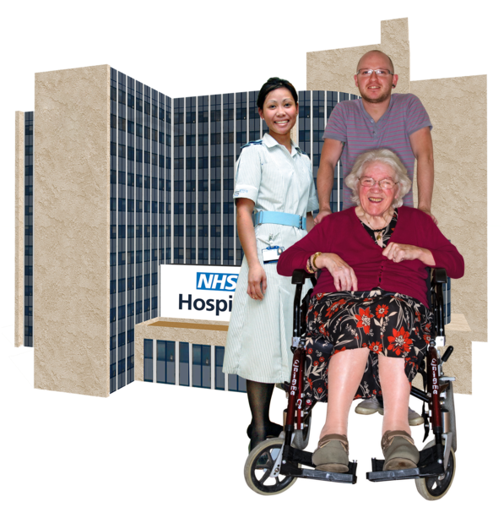
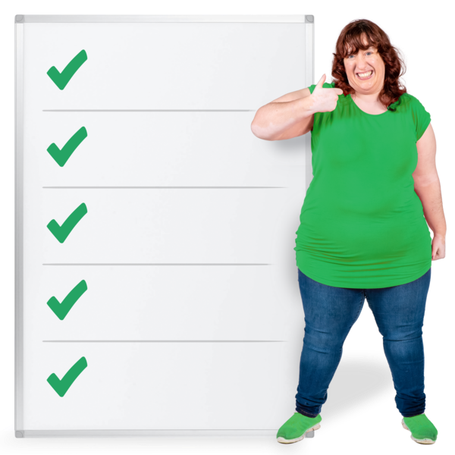
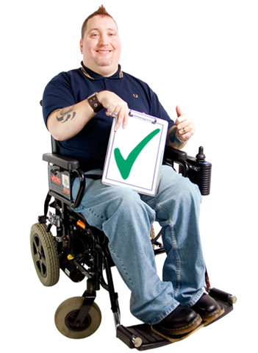
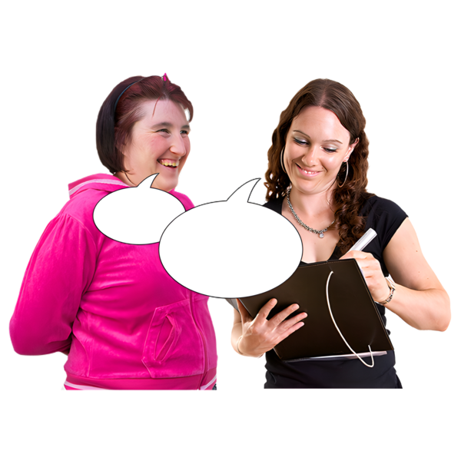
Contents
Page
NHS Frimley ICB
About LeDeR
About this report
Learning and improving
Initial and focused reviews
Our work this year
This year’s reviews
Things we have learned
Contact us
3
4
5
6
7
8
9
13
17
2

Slide 3

NHS Frimley ICB
The Frimley Integrated Care Board (ICB) helps local services to work together:
hospitals
social services
community health services
We work in:
Slough
Windsor and Maidenhead
Bracknell Forest
Surrey Heath
North-East Hampshire and Farnham
3

Slide 4
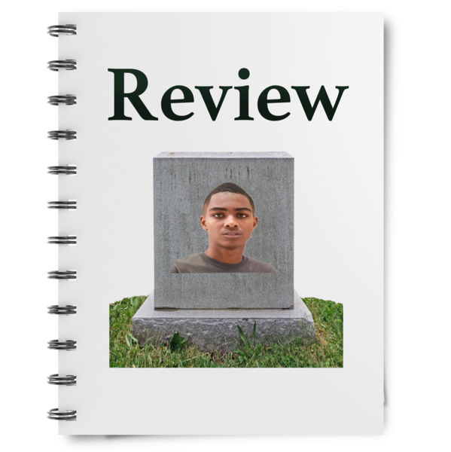
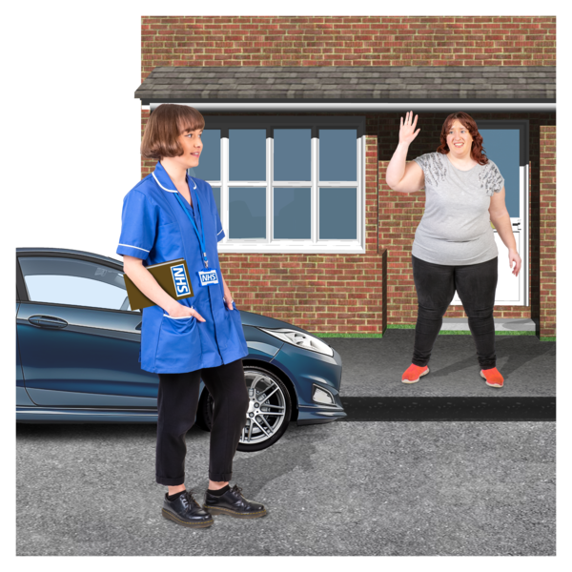
About LeDeR
When someone with learning disabilities or autism dies, we learn about their care and support.
This is called a LeDeR review.
LeDeR reviews help us to make health and care services better.
Health services – some examples:
hospitals
GPs
Care services – some examples:
care homes
help in your own home
4

Slide 5

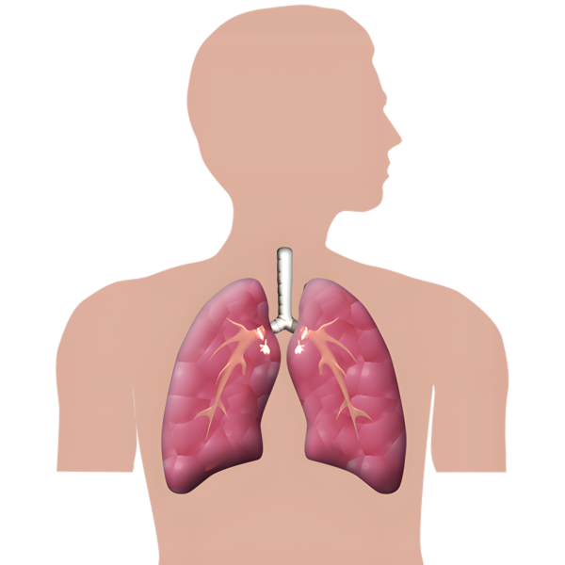
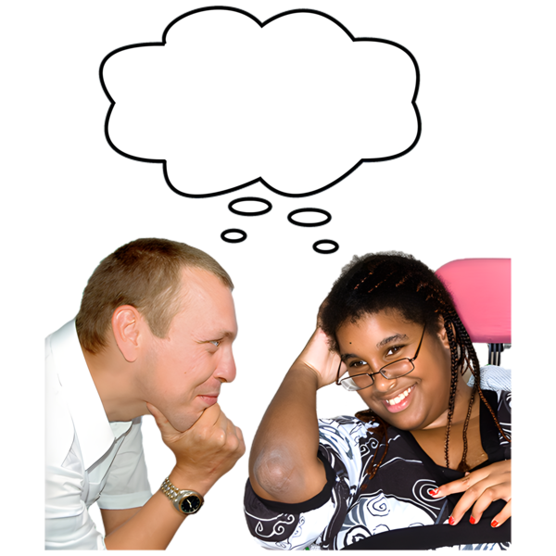

About this report
This report tells you:
how many people’s deaths were reported to LeDeR between
April 2023 and March 2024
the reasons why the deaths happened
things we have learned
our plans for making health and care services better
5

Slide 6

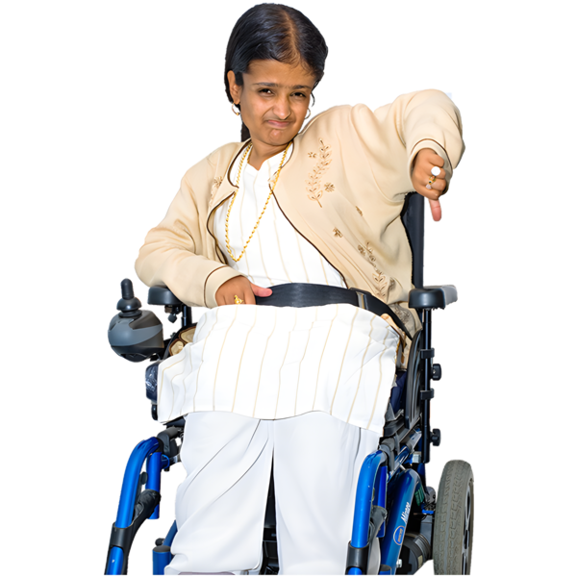

Learning and improving
The things we learn from LeDeR reviews help us to:
Make care better
We find out about poor care.
We do things to make it better.
Reduce health inequality
Health inequality is when some people have worse health and care than other people. This happens because of things like disability, race, and where people live.
Prevent early deaths
Good care helps people to be healthier and live longer.
6

Slide 7
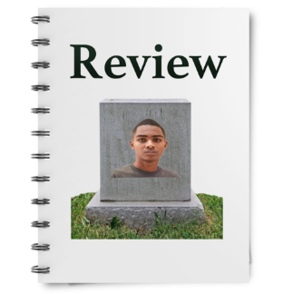
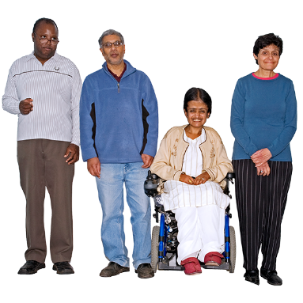
LeDeR reviews
There are 2 types of LeDeR review: initial and focused.
Initial
Every death which is reported to us gets an initial review.
Focused
We do a detailed focused review when the person who died:
had autism but not a learning disability
was from an ethnic minority
did not get good care or treatment
Initial
Focused
7

Slide 8

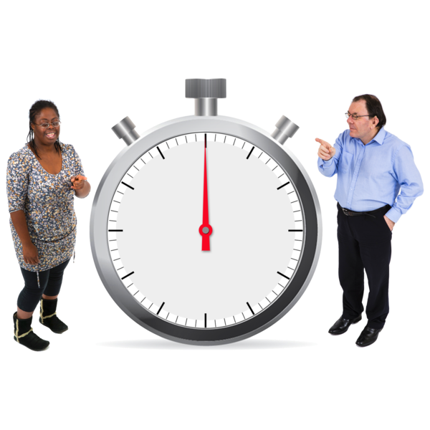
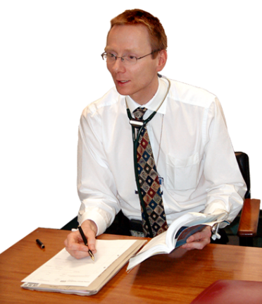
Our work this year
This year we have:
employed 2 new reviewers
improved how we check the quality of reviews
finished reviews more quickly
involved more people, with different skills, in checking and finishing reviews
8

Slide 9
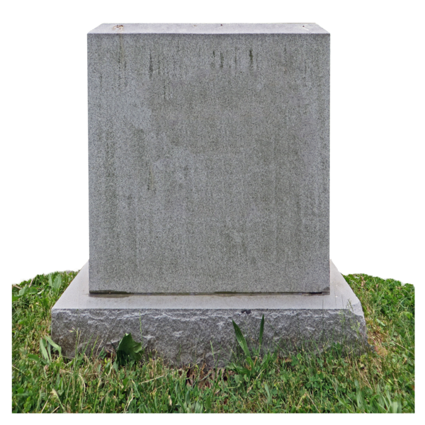


This year’s reviews
39 deaths were reported to us this year: 19 male, 20 female.
2 of these were children.
These reviews were done by the
Child Death Overview Panel.
3 of the deaths reported to us needed focused reviews.
The youngest adult was 38.
The oldest was 90.
Focused
38
90
9

Slide 10

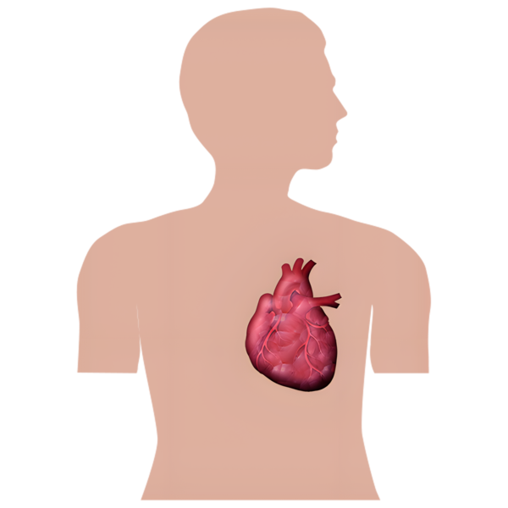
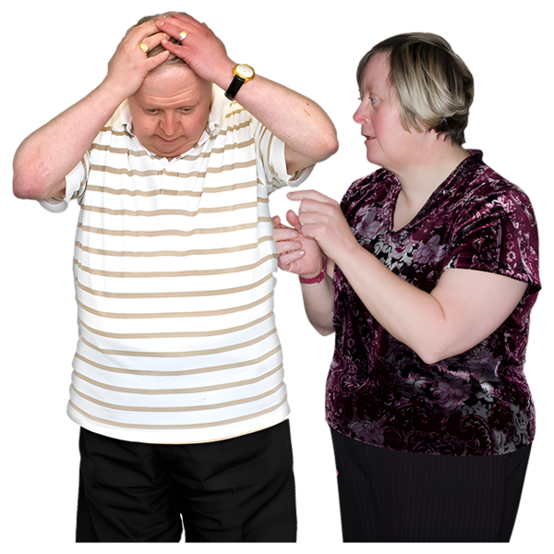
Reasons why people died
Chest infection or pneumonia
6 people
Cancer
5 people
Heart problems
5 people
Dementia
2 people
Other reasons
6 people
10

Slide 11
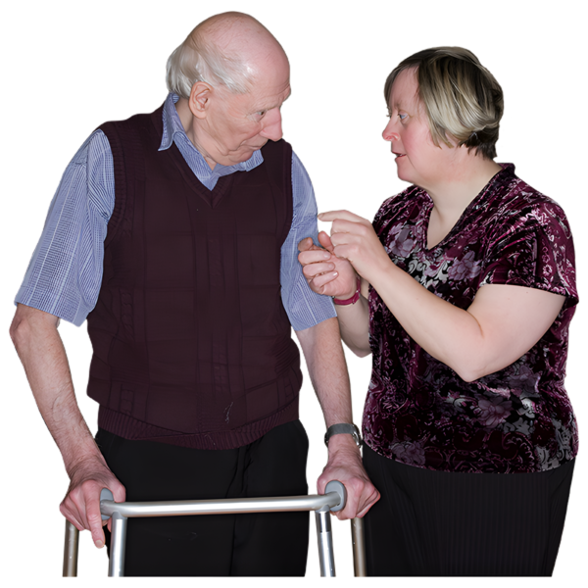
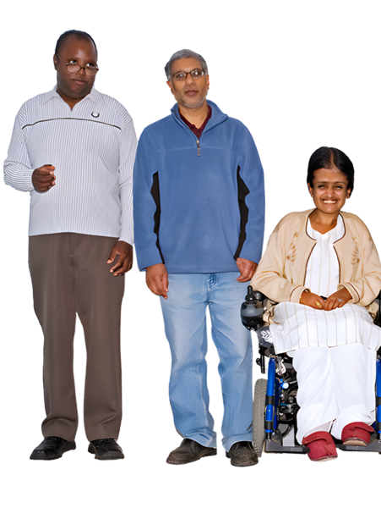

Ethnicity
34 people were White and British
3 people were from other ethnic groups. For example, Pakistani, Caribbean.
2 people did not have information about ethnicity recorded on their review.
The time it takes to do reviews
1 in 5 reviews were finished within
6 months.
11

Slide 12


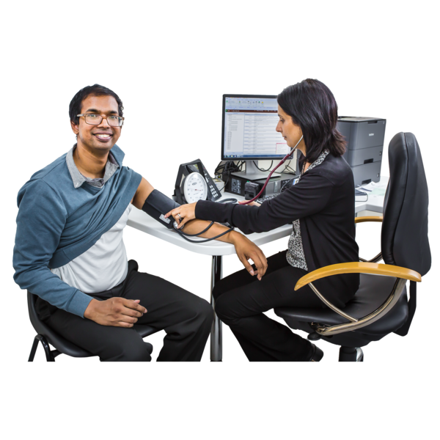
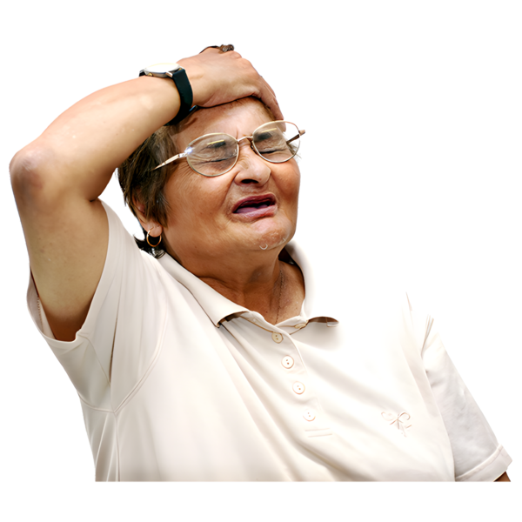
Our 3 priorities
We look for themes during reviews. Themes are similar things that happen to lots of different people.
Themes help us find the most important things to work on: our priorities.
Our 3 priorities this year are to:
Check and improve the quality of Annual Health Checks
Support more people to get screened for cancer
Get better at noticing when a person’s health starts to get worse
12

Slide 13



Things we have learned
Every review tells us about things that went well, and things that could be better.
The full LeDeR report gives you
4 stories:
a 73-year-old man with severe learning disability and autism
a 73-year-old woman with a moderate learning disability
a 59-year-old man with a
moderate learning disability
a 50-year-old woman with a
mild learning disability
63
73
59
50
13

Slide 14

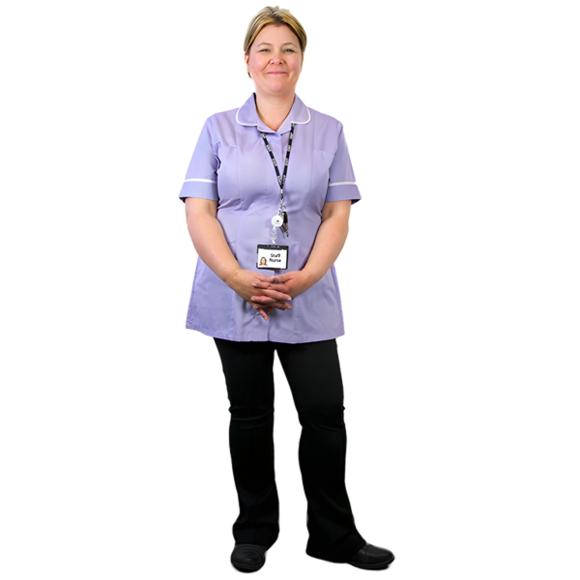
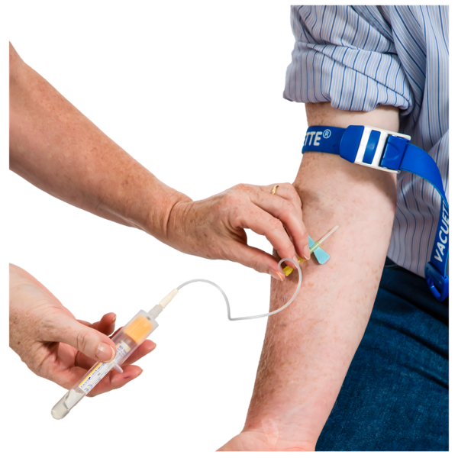
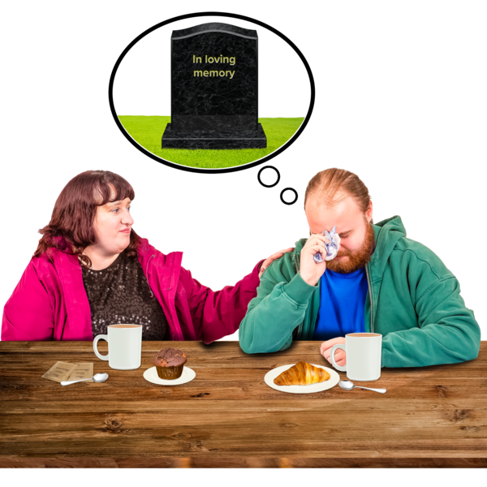
Things that went well
We heard about good care and support:
good support from a learning disability specialist team
excellent care from hospital staff
extra support with medicines, vaccinations and blood tests
good support for a bereaved family
14

Slide 15
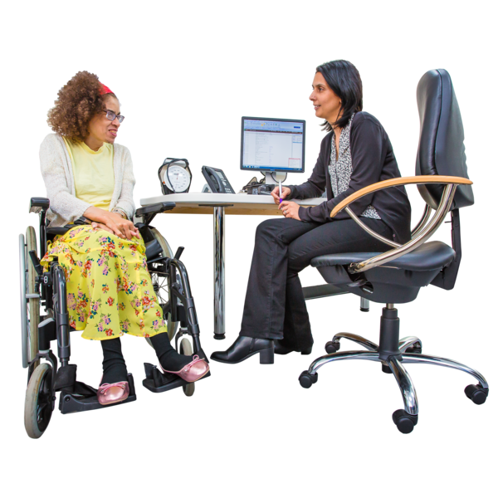
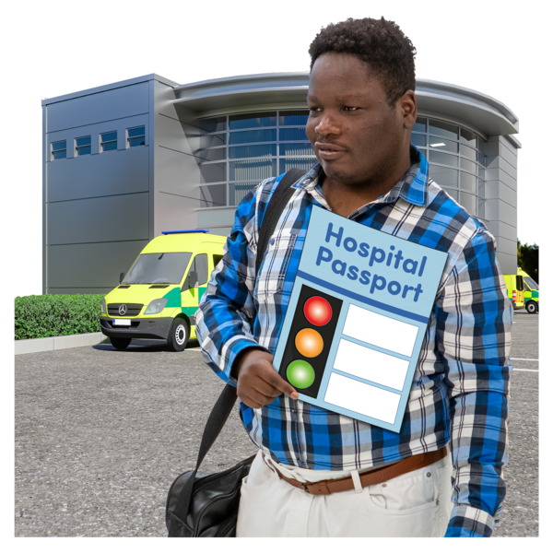
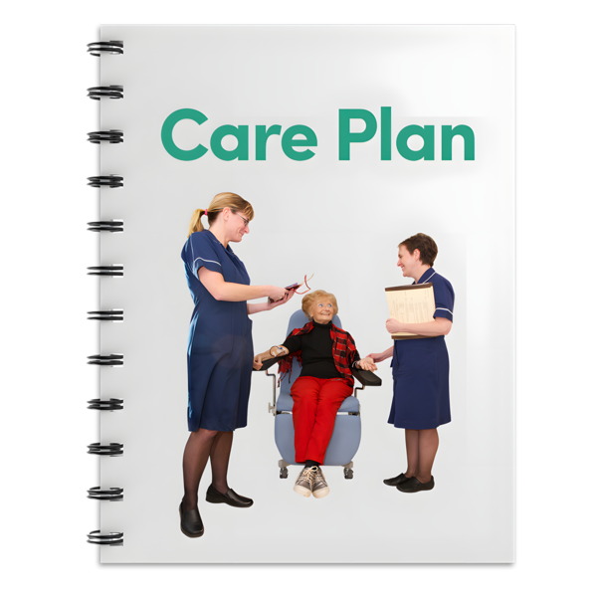
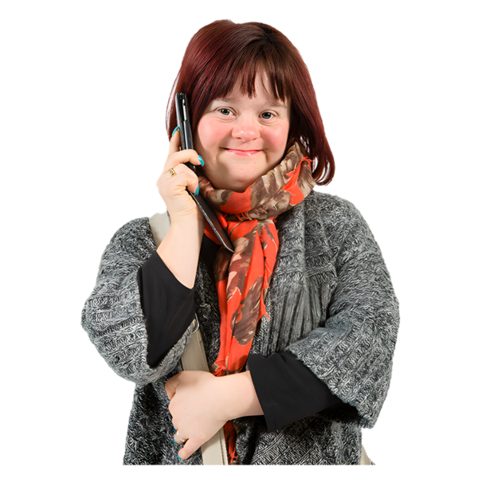
Things to improve
Cancer screening: more support to get tests to check for signs of cancer.
Annual Health Checks: more people need to get their checks.
Health passports: they help hospital staff to learn about the person. We heard about them not being used.
End of life care: people should have a care plan about what should happen
Communication with families needs to be better.
15

Slide 16



Making changes
LeDeR Steering Group
We make sure the things we learn make a difference. We do this by working with other groups and organisations.
For example:
Learning Into Action Group
Local Safeguarding Boards
Strategy for 2023 - 2026
We have a plan about how we will help people with learning disabilities and autism. There are 14 things we want to work on.
16

Slide 17

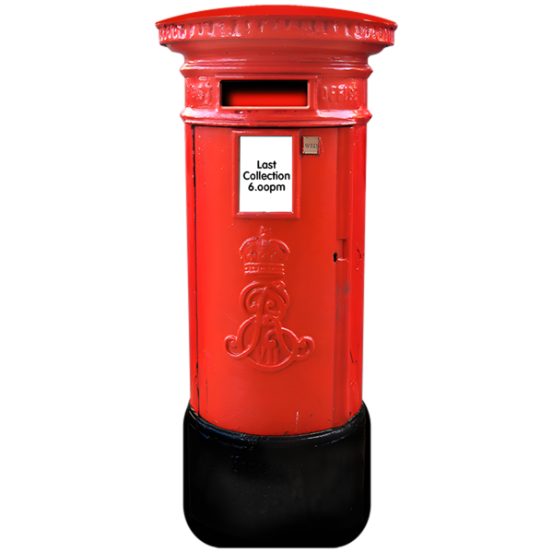
Contact us
Website: https://www.frimley.icb.nhs.uk/
Email:
frimleyicb.public@nhs.net
Post:
NHS Frimley Integrated Care Board
King Edward VII Hospital
St Leonards Road
Windsor
SL4 3DP
17

