Slide 1
Surrey Heath Annual General Meeting Wednesday, 23rd September, 2020 Please turn off your video and mute your microphone for the start of the meeting.

Slide 2
Agenda
Introduction by Dr Andy Brooks
Presentation of the Annual Report and Accounts
Look back on 2019-2020
Our new adult community services
How our budget was spent
Responding to the Covid-19 pandemic
Integrated adult mental health community services
Looking ahead
Questions to the CCG

Slide 3

Looking back at 2019-2020
Once again awarded an ‘Outstanding’ rating by NHS England.
Launched new innovative and integrated community service
Exceptionally high quality family doctor services with all General Practices rated good or outstanding by the Care Quality Commission
In national staff survey 2019, the CCG ranked 5th of all the organisations taking part, continuing to be one of the top rated CCGs by its staff.
Worked together with Surrey County Council to deliver the Health and Wellbeing Strategy and Community Vision for Surrey.
Came together with East Berkshire CCG and North East Hampshire and Farnham CCG to form the Frimley Collaborative of Clinical Commissioning Groups

Slide 4
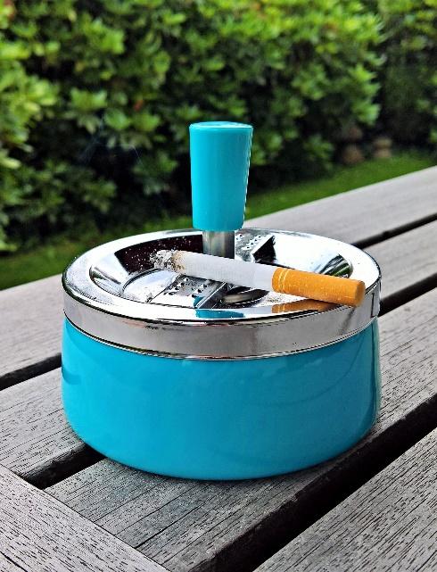
Prevention and self care
Supporting people to live healthy lives is a priority for the CCG. We work with our partners to promote wellness, prevent ill-health, identify improvements in lifestyle choices and ensure effective support is available throughout the community. Prevention programmes for 2019-2020 have included:
In partnership with the One You service, we set up stop smoking services with manual workers at Surrey Heath Borough Council (SHBC) depot and with the Hope Hub homeless service.
Working with NHS England, East Berkshire CCG and North East Hampshire and Farnham CCG we held a successful Diabetes Prevention Programme. The programme offers intensive support and health advice to try to prevent the onset of diabetes.
We ran a successful falls workshop to help identify ways in which we could support fall prevention. Feedback from this workshop has been used to make recommendations locally and across the ICS.

Slide 5

Children and young people
Our vision is to improve access, outcomes and services to children, young people and their families with physical and mental wellbeing needs. In partnership with colleagues in Surrey, we have taken steps to reduce health inequalities for children and young people in line with the NHS Long term plan. This includes:
Introducing specialist paediatric liaison nurse for learning disabilities into all acute hospitals.
All young people with a learning disability will be eligible to be placed on the GP register and should from age 14 receive an annual health check and resulting health action plan.
Supporting schools to develop whole-school approaches to improving emotional wellbeing - Early Intervention Site identified for Surrey Heath. We have begun a partnership project with a local GP, Executive Head of three primary schools and our local CAMHS manager on the Old Dean to better support professionals and families in managing those with additional mental health needs.

Slide 6

Living with and beyond cancer
A new local innovative service run by our Community Cancer Navigator supports people living with and beyond cancer, providing general information and support about cancer and cancer services to enable people to navigate the health and social care system and make informed choices about their cancer and their life.
We aim to increase screening uptake within targeted populations by understanding and overcoming barriers.
We work with GP practices to support earlier diagnosis of through improving uptake for all three national screening programmes (bowel, breast, cervical).
We are improving experience of care for patients and their carers on their cancer journey by ensuring at each stage their feedback is captured.

Slide 7
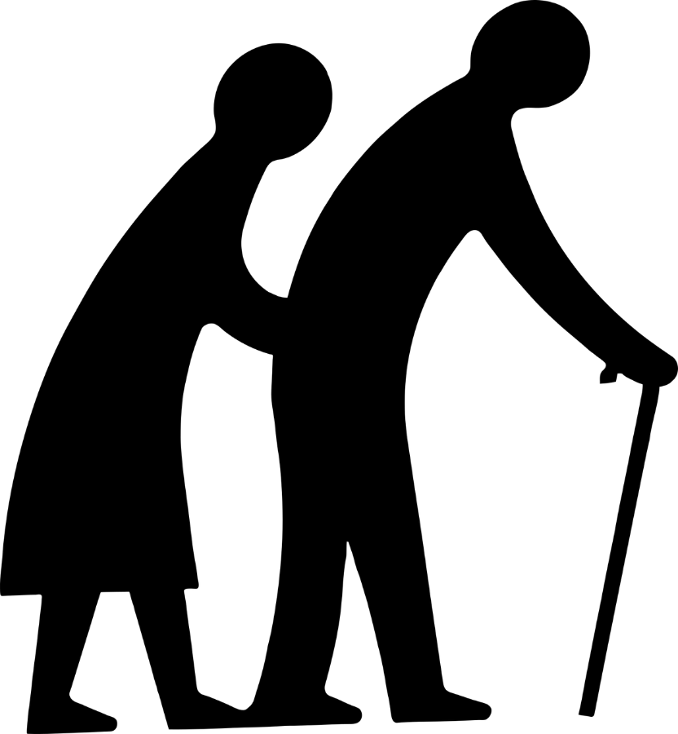
Living with frailty
We want to ensure people are supported to live healthy and independent lives, in their own homes, for as long as possible. We are working with adults who are at risk of loss of independence and increased vulnerability – this can be described more generally as living with frailty.
A Community Frailty Practitioner carries out a holistic assessment in the person’s home or their GP practice to identify what matters to them before making recommendations to keep them safe and well. This may include providing equipment, advice, signposting and referring to other services.
“I would like people to know that I have been very lucky to have had incredible support from the nurses and carers that have visited… they have really lifted my spirits and helped me feel listened to… we got on and they understood how I ticked… everyone has encouraged and supported me, my life is better now.”
Patient feedback

Slide 8

Working in the local community
Homeless community – in partnership with The Hope Hub charity, we provided a mental health support worker at the Hub; stop smoking advice and support; information on medicine management; foot care session; diabetic eye screening; flu jab clinic; and blood pressure testing.
Nepalese community – the Surrey Heath CCG's Diabetes Champion Programme developed five local Nepali’s trained to signpost members of the community to increase understanding of their condition and improve self-care and self-management.
Old Dean, St Michael’s and Watchetts - working with borough, county councillors and community leaders covering Old Dean St Michael’s and Watchetts we ran a three-month project to identify gaps and support to alleviate poverty and reduce potential years of life lost in these communities.
Carers – working with partners continue to support to carers in the local area. The 2019 Christmas carers tea party was well attended and supported by Boots No.7, Costa Coffee, U3A Choir and the Inner Wheel.

Slide 9

How we make commissioning decisions
Effective decision making where quality comes first.
Decisions based on improving health and care outcomes and enhancing patient experience and safety.
Efficient decision making with value for money considered in all instances.
Inclusive and open approach with the views of partners and communities informing our decisions, building confidence and supporting implementation.
Preventative approach with interventions made at the earliest possible opportunity reducing the impact of poor health on individuals, their families and communities.
Contribution to closing the gap for those with the poorest outcomes.

Slide 10
How our budget was spent
The “Plan”
The “Reality”
NOTE 2 and 5
NOTE 18
MONEY RECEIVED (Allocation)
£144.6m
£144.6m
MONEY SPENT
Programme costs £142.7m
Acute £75.9m
Prescribing £13.7m
Community services £12.1m
Mental Health and Learning Disability Services £12.5m
Delegated Commissioning £11.5m
Continuing Care £9.3m
Primary Care £3.8m
Other £3.9m
Programme costs £142.5
Running Costs £2.1m
Running Costs £1.9m
Breakeven planned and achieved

Slide 11
Annual Report and Accounts
Performance Report (p2-79)
Accountability Report (p80-135)
Financial Statements
(p136 to end)
Overview
Who we are and what we do
Local needs
Our business model
Successes in 2018-19 (including Member Practices’ Report)
Principal risks and uncertainties facing the CCG
Assurance (including Going Concern)
Members Report
Statement of Accountable Officer Responsibilities
Annual Governance Statement
Remuneration Report and Staff Report
Report and Opinion from independent Auditor
Statement of Comprehensive Net Expenditure
Statement of Financial Position
Statement of changes in taxpayers equity
Statement of cash flows
Notes to the Accounts (inc Accounting Policies)
Performance Analysis
How the CCG performed against constitutional standards and performance targets.
What the CCG spent in 2018-19
How the CCG delivered its plan for 2018-19
Improving the quality of services
Involving the public
Reducing inequalities
Sustainable development
Sustainability report
External environment
Equality report

Slide 12
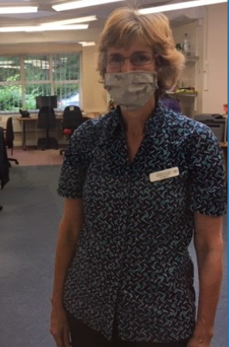
Responding to the Covid-19 pandemic
Faster decision making
More use of technology – professionally and personally
National policy and
guidance increased
Speed of change (reactive and proactive)
Our organisational structure and processes changed very rapidly – Covid specific response, redeployment, working from home.

Slide 13
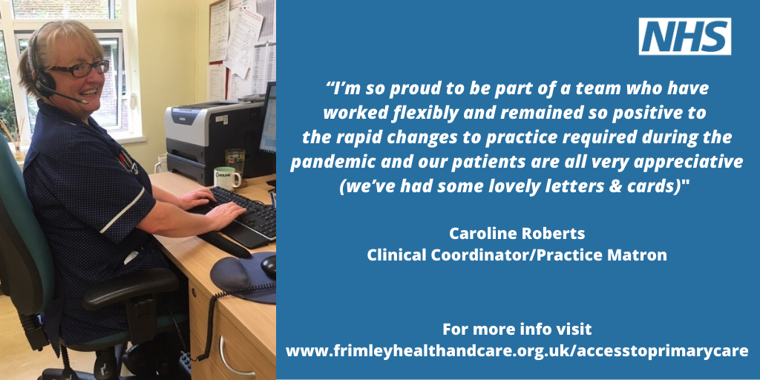

Slide 14

Health recovery: what’s next
We have transformed how we work – demonstrating rapid learning and effective working with our Covid-19 Pandemic response.
Some of these changes need to continue. This includes continued roll-out of telephone and video consultations at hospitals outpatients and GP practices and new emergency care for those with mental health issues.
When the spread of the virus was increasing at a significant rate in March, we needed to make sure there was enough bed capacity and staff to cope with the predicted surge in demand. Health and care workers across Frimley Health and Care are focussed on restarting some of the services that were suspended as part of the national Covid-19 effort.
We will need to continue to be flexible to ensure we are able to manage the ongoing Covid-19 situation in the best possible way. Services may be delivered in different ways and in different places than previously, and if Covid-19 cases begin to rise again then these services may need to be reduced once more.

Slide 15
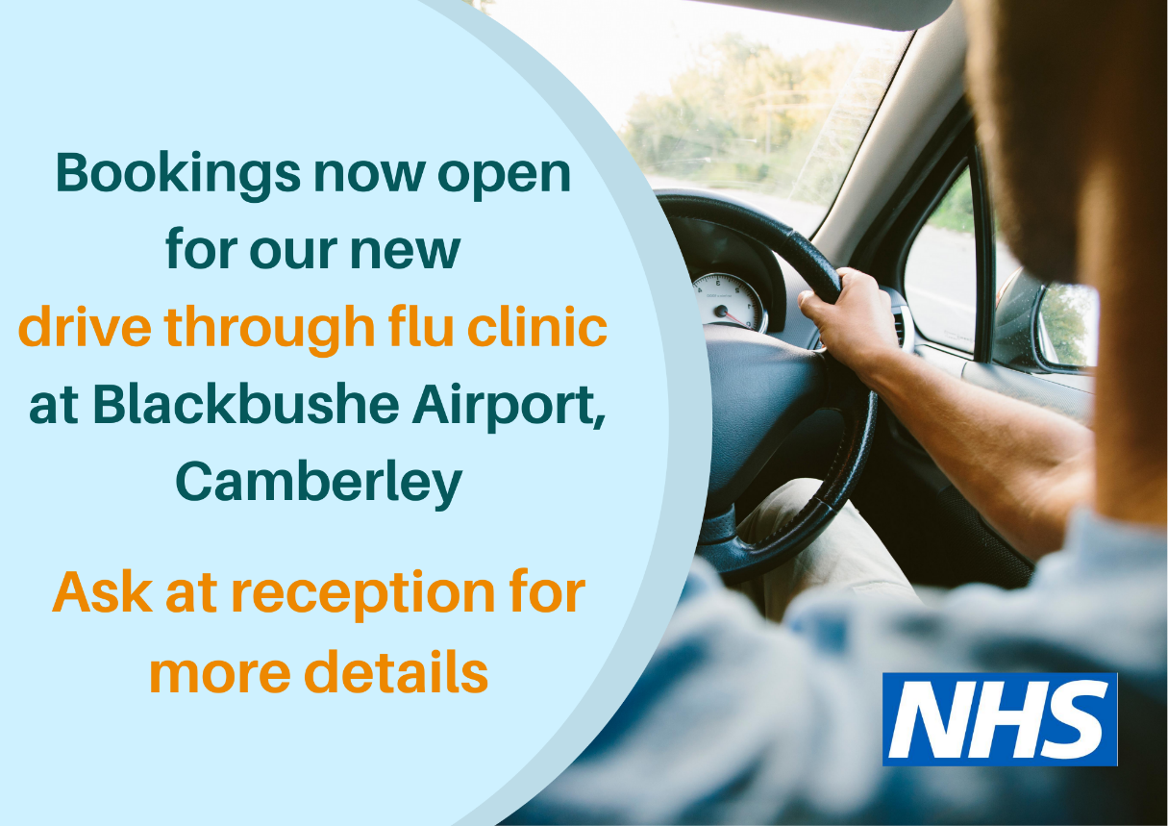
Looking ahead
Stay Well This Winter
Covid-19 – recovery and restoration
NHS 111 First
Community Deal
To ensure safe delivery of the flu vaccination we are holding a drive through clinic at Blackbushe Airport, Camberley.
Drive through clinic opened Monday, 21st September
Will operate for an initial period of seven weeks with potential to extend
To book in, contact your GP surgery

Slide 16

Do you have a question?
Pop your question in the chat box below.

Slide 17
Please let us know how we did
Thank you for joining us for this virtual annual general meeting.
You will now be presented with a short survey to give us your feedback on this meeting.

Slide 18
